Slide 1


Mansoura University Faculty of Computers and Information First Semester- 2020-2021
Computer Graphics
Grade: 2nd Year (General –BIO)
Course Instructors :
Assoc. Prof. Dr-Haitham El-Ghareeb
Dr-Ibrahim El-Hassanoni waleed mohamed

Slide 2
Chapter 06- Math and Animation for game Developers

Slide 3
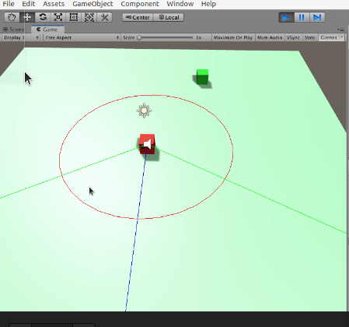
Lecture Demo Application in unity
Source code and explanation videos are available at Google Drive Link

Slide 4
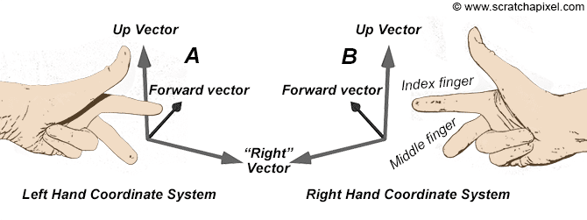
Orientation of vectors Left-hand system vs right-hand system
In the right-hand system (RH), when curling your fingers around the z-axis with the thumb pointing toward the z positive direction, your fingers point from the x-axis toward the y-axis.
In the left system, it is the same method but using the left hand.

Slide 5
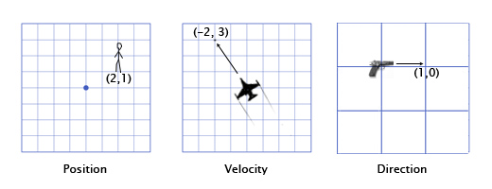
Vector
In games, vectors are used to store:
positions,
directions,
and velocities.
Here are some 2-Dimensional examples:
The position vector indicates that the man is standing two meters east of the origin, and one meter north.
The velocity vector shows that in one minute, the plane moves three kilometers up, and two to the left.
The direction vector tells us that the gun is pointing to the right.

Slide 6
Vector addition
To add vectors together, you just add each component together separately. For example:
(0,1,4) + (3,-2,5) = (0+3, 1-2, 4+5) = (3,-1,9)
One of the most common applications in games for vector addition is physics integration.
Any physically-based object will likely have vectors for position, velocity, and acceleration
التغير في سرعة الحركة (العجلة).

Slide 7
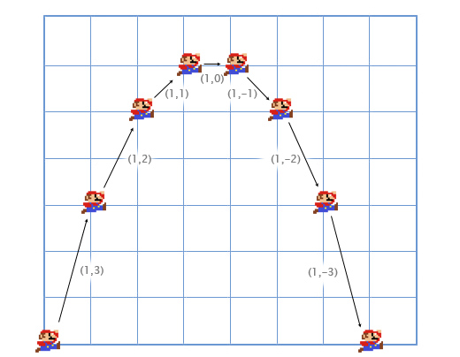
Vector addition Example
Let's consider the example of Mario jumping:
He starts at position (0,0). As he starts the jump, his velocity is (1,3) -- he is moving upwards quickly, but also to the right.
His acceleration throughout is (0,-1), because gravity is pulling him downwards. Here is what his jump looks like in 7 frames. The black text specifies his velocity for each frame.

Slide 8
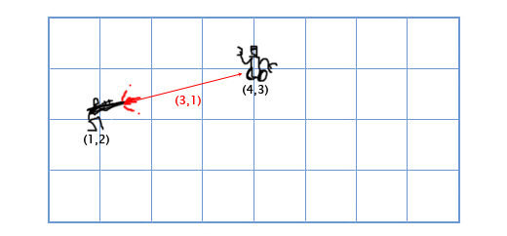
Vector subtraction
subtracting one component at a time.
Vector subtraction is useful for getting a vector that points from one position to another.
For example, let's say the player is standing at (1,2) with a laser rifle, and an enemy robot is at (4,3). To get the vector that the laser must travel to hit the robot, you can subtract the player's position from the robot's position. This gives us:
(4,3)-(1,2) = (4-1, 3-2) = (3,1).

Slide 9
Scalar-vector multiplication
When we talk about vectors, we refer to individual numbers as scalars. For example, (3,4) is a vector, 5 is a scalar.
In games, it is often useful to multiply a vector by a scalar.
For example, we can simulate basic air resistance by multiplying the player's velocity by 0.9 every frame.
To do this, we just multiply each component of the vector by the scalar. If the player's velocity is (10,20), the new velocity is:
0.9*(10,20) = (0.9*10, 0.9*20) = (9,18).

Slide 10
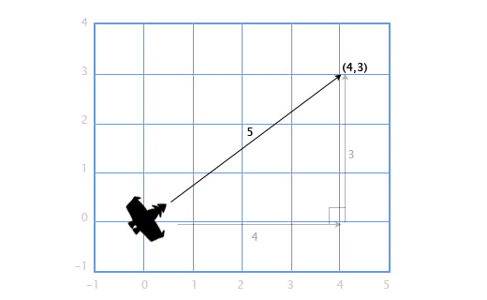
Vector Length (magnitude)
If we have a ship with velocity vector V (4,3), we might also want to know how fast it is going, in order to calculate how much fuel it should use.
To do that, we need to find the length (or magnitude) of vector V. The length of a vector is often written using || for short, so the length of V is |V|.
We can think of V as a right triangle with sides 4 and 3, and use the Pythagorean theorem نظرية فيثاغورث to find the hypotenuse: x² + y² = h².
That is, the length of a vector H with components (x,y) is sqrt(x²+y²)
الجذر التربيعي . So, to calculate the speed of our ship, we just use:
|V| = sqrt(4²+3²) = sqrt(25) = 5
This works with 3D vectors as well -- the length of a vector with components (x,y,z) is sqrt(x²+y²+z²).

Slide 11
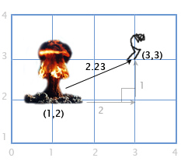
Distance
If the player P is at (3,3) and there is an explosion E at (1,2), we need to find the distance between them to see how much damage the player takes.
This is easy to find by combining two tools we have already gone over: subtraction and length.
We subtract P-E to get the vector between them, and then find the length of this vector to get the distance between them.
The order doesn't matter here, |E-P| will give us the same result.
Distance = |P-E| = |(3,3)-(1,2)| = |(2,1)| = sqrt(2²+1²) = sqrt(5) = 2.23

Slide 12
Normalization
When we are dealing with directions (as opposed to positions or velocities), it is important that they have unit length (length of 1). This makes programming a lot easier.
A vector with a length of 1 is called "normalized". So how do we normalize a vector (set its length to 1)? we divide each component by the vector's length.
Example: If we want to normalize vector V with components (3,4), we just divide each component by its length, 5, to get (³/₅, ⁴/₅). Now we can use the pythagorean theorem to prove that it has length 1:
(³/₅)² + (⁴/₅)² = ⁹/₂₅ + ¹⁶/₂₅ = ²⁵/₂₅ = 1

Slide 13
Dot product
To get the dot product of two vectors, we multiply the components, and then add them together.
(a₁,a₂)•(b₁,b₂) = a₁b₁ + a₂b₂
For example, (3,2)•(1,4) = 3*1 + 2*4 = 11.
This seems kind of useless at first, but lets look at a few examples in next slides

Slide 14
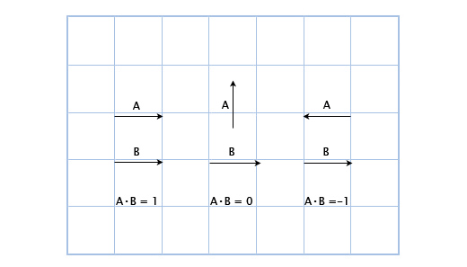
Example 1: Dot Product
Example 1:
Here, we can see that when the vectors are pointing the same direction , the dot product is positive.
When they are perpendicular , the dot product is zero, متعامدان
and when they point in opposite directions , it is negative.
Basically, it is proportional to how much the vectors are pointing in the same direction. This is a small taste of the power of the dot product, and it's already pretty useful!

Slide 15

Example 2: Dot Product
Example 2 : Let's say we have a guard at position G (1,3) facing in the direction D (1,1), with a 180 field of view. We have a hero sneaking by at position H (3,2). Is he in the guard's field of view?
We can find out by checking the sign of the dotproduct of D and V (the vector from the guard to the hero). This gives us:
V = H-G = (3,2)-(1,3) = (3-1,2-3) = (2,-1) D•V = (1,1)•(2,-1) = 1*2+1*-1 = 2-1 = 1
Since 1 is positive, the hero is in the guard's field of view!

Slide 16
Using Dot Product to get angle
We know that the dot product is related to the extent to which the vectors are pointing in the same direction, but what is the exact relation? It turns out that the exact equation for the dot product is:
AB = |A||B|cosθ
Where θ (pronounced "theta") is the angle between A and B. This allows us to solve for θ if we want to find out the angle:
θ = acos([AB]/[|A||B|]).
As I mentioned before, normalizing vectors makes our life easier! If A and B are normalized, then the equation is simply:
θ = acos(AB)

Slide 17

Example 3: Using Dot Product to Get Angle
Let's revisit the guard scenario above, except the guard's field of view is only 120.
First, we get the normalized vectors for the direction the guard is facing (D'), and the direction from the guard to the hero (V').
Then, we check the angle between them. If it is greater than 60 (half of the field of view), then the hero is not seen.
D' = D/|D| = (1,1)/sqrt(1²+1²) = (1,1)/sqrt(2) = (0.71,0.71) V' = V/|V| = (2,-1)/sqrt(2²+(-1)²) = (2,-1)/sqrt(5) = (0.89,-0.45)
θ = acos(D'V') = acos(0.71*0.89 + 0.71*(-0.45)) = acos(0.31) = 72
The angle between the center of the guard's vision and the hero is 72, so the guard does not see him!

Slide 18
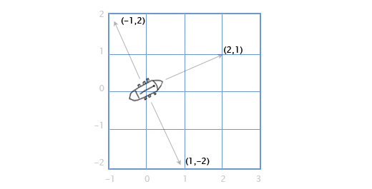
Cross Product (special 2d case)
Let's say you have a boat that has cannons that fire to the left and right. Given that the boat is facing along the direction vector (2,1), in which directions do the cannons fire?
This is easy in 2D:
to rotate 90 degrees clockwise مع عقارب الساعة, just flip بدل the two vector components, and then switch the sign of the second component. (a,b) becomes (b,-a). So, if the boat is facing along (2,1), the right-facing cannons fire towards (1,-2).
The left-facing cannons fire in the opposite direction, so we flip both signs of right facing vector to get: (-1,2).

Slide 19
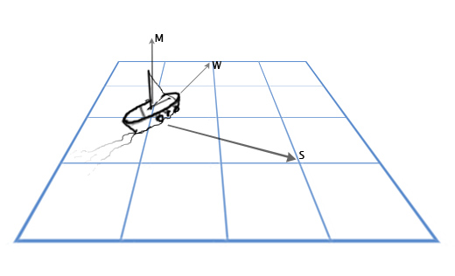
Cross Product-2
So, what if we want to do this in 3D?
Let's revisit our sailing ship. We have a vector for the direction of the mast M, going straight up (0,1,0), and the direction of the north-north-east wind W (1,0,2), and we want to find the direction the sail S should stick out in order to best catch the wind. The sail has to be perpendicular to the mast, and also perpendicular to the wind. To solve this, we can use the cross product: S = M x W.

Slide 20
Cross Product-3 (Continue example)
The cross product of A(a₁,a₂,a₃)) and B(b₁,b₂,b₃)) is:
(a₂b₃-a₃b₂, a₃b₁-a₁b₃, a₁b₂-a₂b₁)
So now we can plug in our numbers and solve our problem:
S = MxW = (0,1,0)x(1,0,2) = ([1*2-0*0], [0*1-0*2], [0*0-1*1]) = (2,0,-1)

Slide 21
LINEAR INTERPOLATION (LERP)

Slide 22
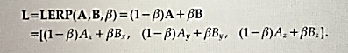
The linear interpolation (LERP)
one of the most common operations used in game development.
For example, if we want to smoothly animate from point A to point B over the course of two seconds at 30 frames per seconds, we would need to find 60 intermediate positions between A and B.
A linear interpolation is a mathematical operation to find an intermediate point between two known points. The operation can be defined as follows:
Where β is a value between 0 and 1 where 0 represents the initial position of the Lerp and 1 as the final position.

Slide 23
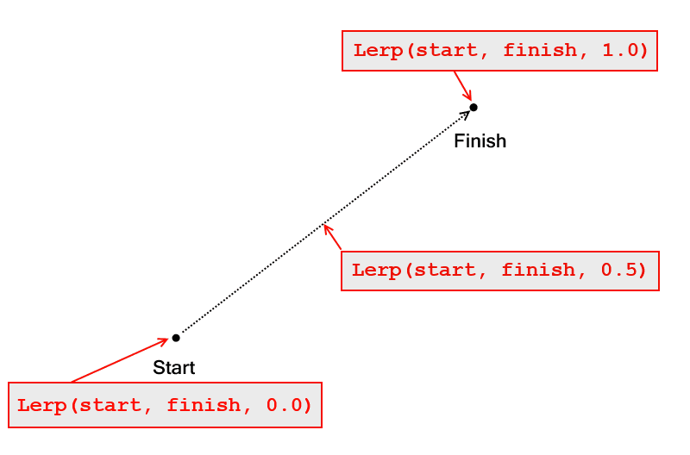
Example

Slide 24
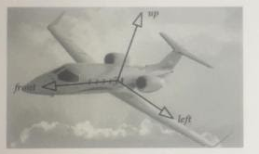
Model space (world and view coordinates)
The model space is the reference system used by the object in question.
For example, a character game object’s forward axis points in the direction that the object is naturally facing.
Up: is the direction that point towards the top of the object
The left or right are the axes that points to its left or right sides respectively.
Example with a plane:

Slide 25
World coordinate
A word coordinate is a fixed coordinate in which position, orientation, and scale of all the elements placed in the game are described.
The origin of the coordinate system is arbitrary, but it is a common practice to place it in the center of the world in order to reduce the number of floating point numbers needed to describe objects very far away from the origin.
The orientation of the axes is also arbitrary but usually, the convention is to have the y-axis as the axis pointing upward.

Slide 26
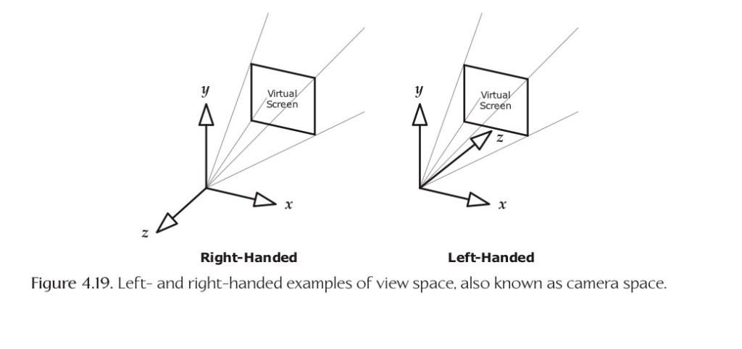
View space
The view space coordinates are often called as the camera coordinates. These are the coordinates fixed or attached to the game camera.

Slide 27
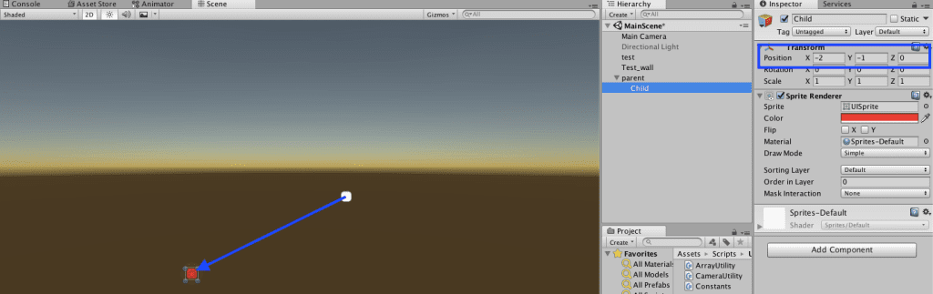
Coordinate space hierarchy
A coordinate space hierarchy is a coordinate system that expresses its position based on its parent object. For example, assuming you have a character with an arm attached. The vector that expresses the position of that arm is based on the coordinate system of its parent.

Slide 28
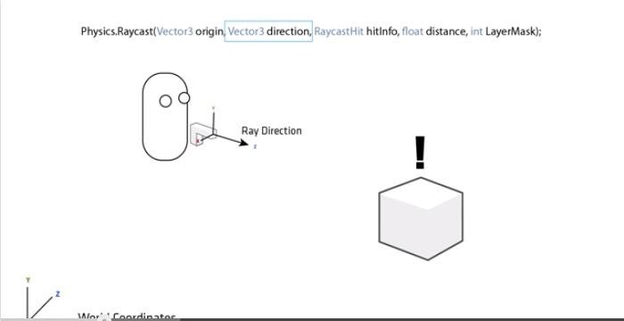
Raycasting
Ray casting is a common technique used in games to find when a line (ray) has hit a specific target. A common example is when a bullet is shot from a gun. As you can imagine, we’ll have to use Vectors to be able to correctly use the Ray Casting function available in most game engines.
Let’s take this example from the Unity Tutorials:

Slide 29
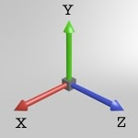
Cartesian & Spherical coordinates
A point in the cartesian coordinate system can be defined using a vector (x,y,z) from the origin to the point

Slide 30
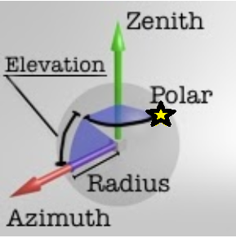
Cartesian & Spherical coordinates
Spherical coordinate system :
Spherical coordinate system is an alternative coordinate system, where two orthogonale coordinate axis define the world space in 3D.
The zenith axis points upwards
and the azimuth axis points to the side.
مثل خطوط الطول ودوائر العرض
To define a point in this system the following is needed:
Radius: the distance from the origin to the point
Elevation angle: the angle between the plane (with zenith axis as normal) and the line from the origin to the point
Polar angle: the rotation around the zenith axis
(the star represents point with the measured angle)

Slide 31
Applications of Spherical coordinates
1- 3d map visualization
2-Chase camera:
The camera movement is restricted to move around the player giving – a perfect example of how to use spherical coordinates.
The radius is simple the distance between the player character and the camera,
the elevation angle can be mapped to the vertical joystick state
and the polar angle can be mapped to the horizontal joystick state.

Slide 32
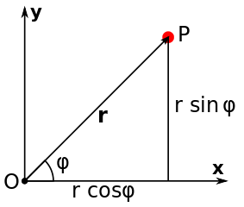
Polar, Spherical and Geographic Coordinates
للاطلاع فقط
Then the conversion from a cartesian vector (x, y) of a position P to polar coordinates (radius, angle) is:
radius = sqrt(x^2 + y^2)
angle = atan2(y, x)
and the way around:
x = radius * cos(angle)
y = radius * sin(angle)

Slide 33
Parametric curves
You are probably familiar with curves like y = x² or f(x)=x². A parametric curve is similar to those, but the x- and y-values are calculated in separate functions. To do this we need another variable (I will call it a). So instead of f(x), we say X(a) and Y(a), where X(a) gives you an x-value for each value of a, and Y(a) gives you an corresponding y-value for the same value of a. Here is an example:
X(a) = a/2
Y(a) = a+5
If we substitute a with a number we can get a point that lies on the curve/line:
a = 6
X(6) = 6/2 = 3 = x
Y(6) = 6+5 = 11 = y
We now know that (3,11) is a point on the curve.
We can easily make a curve in 3D just by defining Z(a).

Slide 34
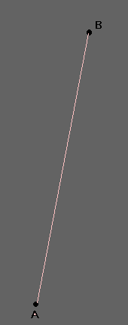
Bezier curves: 1- Simple line
The simplest form is a straight line from a control point A, to a control point B.
I will use Ax to denote the x-coordinate of control point A, and Ay to denote the y-coordinate. The same goes for B.
I am introducing another variable, b, just to make it a bit more simple to read the functions. However, the variable b is only a in disguise, b is always equal to 1-a. So if a = 0.2, then b = 1-0.2 = 0.8. So when you see the variable b, think: (1-a).
This parametric curve describes a line that goes from point A, to point B when the variable a goes from 1.0 to 0.0:
X(a) = Ax·a + Bx·b
Y(a) = Ay·a + By·b
Z(a) = Az·a + Bz·b
If you set a = 0.5 (and thus also b = 0.5, since b = 1.0-a = 1.0-0.5 = 0.5) then X(a), Y(a) and Z(a) will give you the 3D coordinate of the point on the middle of the line from point A to point B.

Slide 35
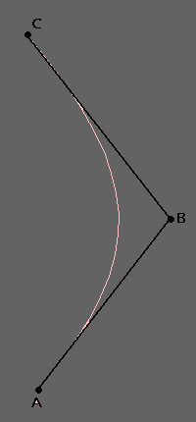
2-Quadratic (curves)
This: (a+b)=1, where b = (1.0-a) is the key to everything.
We know that a polynomial function is a curve, so why not try to make (a+b) a polynomial function? Let's try:
(a+b)² = a² + 2a·b + b²
Knowing that b=1-a we see that a² + 2·a·b + b² is still equal to one, since (a+b) = 1, and 1² = 1.
We now need three control points, A, B and C, where A and C are the end points of the curve, and B decides how much and in which direction it curves. Except for that, it is the same as with the parametric line.
X(a) = Ax·a² + Bx·2·a·b + Cx·b²
Y(a) = Ay·a² + By·2·a·b + Cy·b²
Z(a) = Az·a² + Bz·2·a·b + Cz·b²
Still, if you set a = 0.5, then a² = 0.25, 2·a·b = 0.5 and b² = 0.25 giving the middle point, B, the biggest impact and making point A and C pull equally to their sides. If you set a = 1.0, then a² = 1.0, a·b = 0.0 and b² = 0.0 meaning that result is the control point A itself, just the same as setting a = 0.0 will return the coordinates of control point C.

Slide 36
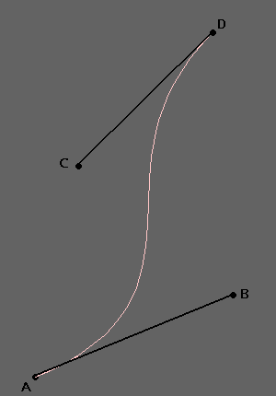
3-Cubic
We can also increase the number of control points using (a+b)³ instead of (a+b)², giving you more control over how to bend the curve.
(a+b)³ = a³ + 3·a²·b + 3·a·b² + b³
Now we need four control points A, B, C and D, where A and D are the end points.
X(a) = Ax·a³ + Bx·3·a²·b + Cx·3·a·b² + Dx·b³
Y(a) = Ay·a³ + By·3·a²·b + Cy·3·a·b² + Dy·b³
Z(a) = Az·a³ + Bz·3·a²·b + Cz·3·a·b² + Dz·b³

Slide 37
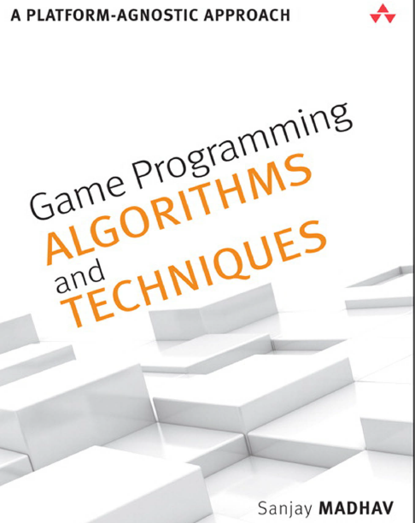
Basics of Game programming
Based on Textbook 2: “Game Programming Algorithms and Techniques- A Platform-Agnostic Approach”, Sanjay Madhav,2014, ch1

Slide 38
The Game Loop
The game loop is the overall flow control for the entire game program.
It’s a loop because the game keeps doing a series of actions over and over again until the user quits.
Each iteration of the game loop is known as a frame .
Most real-time games update several times per second: 30 and 60 are the two most common intervals.
If a game runs at 60 FPS ( frames per second ), this means that the game loop completes 60 iterations every second.

Slide 39
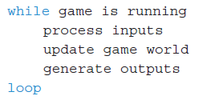
Traditional Game Loop
A traditional game loop is broken up into three distinct phases: processing inputs, updating the game world, and generating outputs. At a high level, a basic game loop might look like this:

Slide 40
Game Loop (continue)
processing inputs : detecting any inputs from devices such as a keyboard, mouse, or controller.
Updating the game world : going through everything that is active in the game and updating its state and making decisions.
generating outputs, the most computationally expensive output is :
graphics, which may be 2D or 3D.
audio including sound effects, music,
and dialogue
Others…

Slide 41
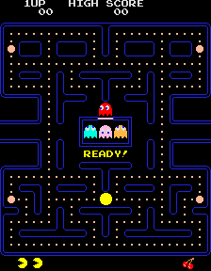
Example: pacman game

Slide 42
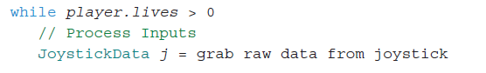
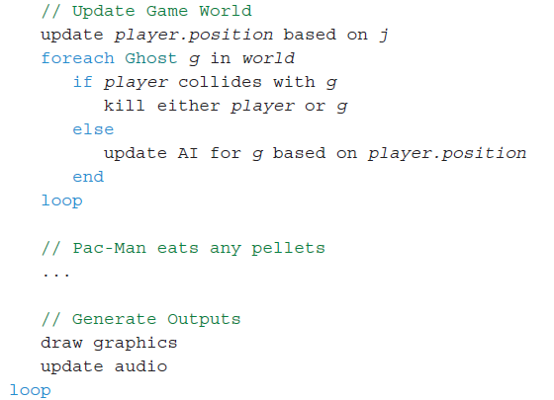
Example: Theoretical Pac-Man Game Loop

Slide 43
Multithreaded Game Loops
Some mobile and independent Games still use a variant of the traditional game loop.
But most Large Games do not.
That’s because newer hardware features CPUs that have multiple cores.
This means the CPU is physically capable of running multiple lines of execution, or threads , at the same time.

Slide 44
Time and Games
The majority of video games have some concept of time counting.
For real-time games, that progression of time is typically measured in fractions of a second.
As one example, a 30 FPS game has roughly 33ms (1000ms divided by 30 frames) elapse from frame to frame.

Slide 45
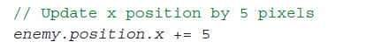
Logic as a Function of Delta Time
Early games were often programmed with a specific processor speed in mind.
as long as it worked properly on that processor it was considered acceptable.
Example: the next code updates enemy position by 5 pixels to the right every Frame. ( 150 pixels in 1 second for 30 FPS devices)
What if the game is run on another device with 60 FPS? (300 pixels per second which is more than desired speed).

Slide 46
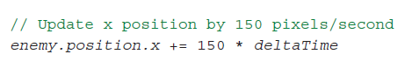
Solution: concept of delta time
concept of delta time : the amount of elapsed game time since the last frame.
جزء من الثانية
think of the movement not in terms of pixels per frame, but in terms of pixels per second.
So if the ideal movement speed is 150 pixels per second, this pseudocode would be preferable:

Slide 47
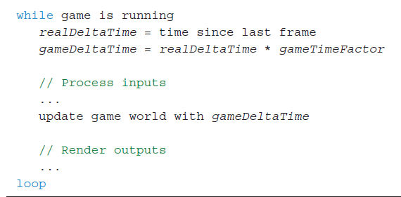
Game Loop with Delta Time
Note: gameTimeFactor سرعة الحركة can be speed factor, with values like :
0 for no speed
0.25 / 0.5 slower speed
1 for normal speed,
2 for double speed
More then 1 for more speed

Slide 48
2D GRAPHICS

Slide 49
Why 2D games are famous?
Suitable to Mobile and web Platforms
Developers are drawn to 2D because the typical budget and team can be much smaller.
Gamers are drawn toward 2D because of the simplicity of the games.
Many techniques are common between 2D and 3D games

Slide 50
Sprites صور ثنائية الأبعاد
A sprite is a 2D visual object within the game world that can be drawn using a single image on any given frame.
Sprites can be used to represent:
characters
other dynamic objects.
backgrounds,
Most 2D games have a lot of sprites,
Mobile games the sprites often takes most of game size.
it’s important to try to use sprites efficiently

Slide 51
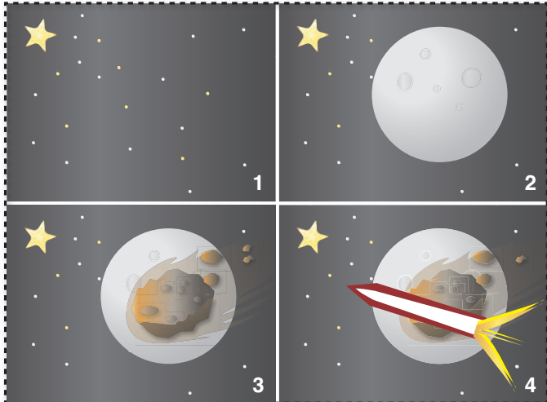
Drawing Sprites
Suppose you have a basic 2D scene with a background image and a character in the center.
Painter’s Algorithm : The simplest approach to drawing this scene would be to:
first draw the background image
then draw the character.
In the painter’s algorithm, all the sprites in a scene are sorted from back to front (based on Z-Order/Depth value)

Slide 52
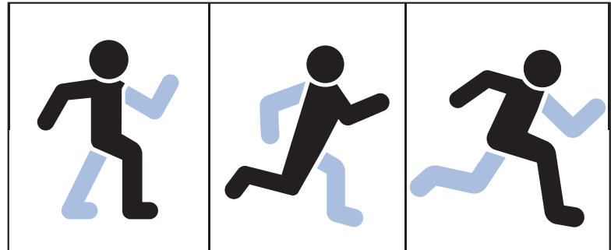
Animating Sprites
Common technique: A series of static 2D images are played fast to create an feeling of motion
minimum of 24 FPS is required
This means that for every one second of animation, you need 24 individual images
Some games use 60 FPS animations

Slide 53
Sprite Sheets
it is preferable to have all the sprites for a particular character be the same size.
many libraries also required that all image files had dimensions that were powers of two, (32x32, 64x64, ….) for performance optimization (faster drawing).
A developer can have an individual image file (or texture ). But this will waste a great deal of memory.
That’s because sprites usually aren’t rectangles, so, rectangle contains unused areas.
A solution to this problem is to use a single image file that contains all the sprites, called a sprite sheet .

Slide 54
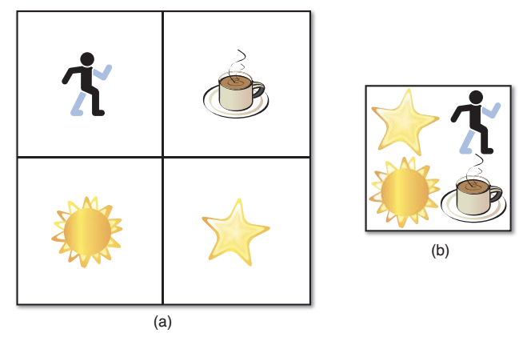
Sprite Sheets (2)
In a sprite sheet, sprites are grouped closely and overlap the unused space تقاطع.
This means that when the sprite sheet is opened, a bit of work is necessary to reconstruct the correct images in memory.
This reduces total installation size of the game.
Individual sprites (a), and those sprites packed in a sprite sheet (b)

Slide 55
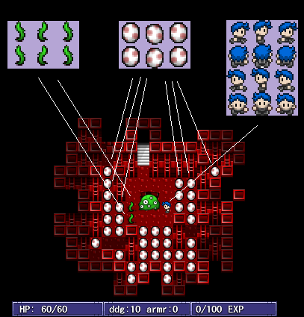
Sprite Loading
You should only load a sprite sheet image once
Each behavior using the sprite maintains a reference to the sprite sheet
Consider making a Resource class which loads in sprite sheets
Load in image
Handling image index for different sprites
Generalizable to other assets like maps, sounds, text, etc…
Notes:
You’re going to want load in sprites. But only want to do it once.
55

Slide 56
Relative Paths
For All Resource Files:
Don’t use absolute paths
“/gpfs/main/home/<login>/course/cs1971/tac/resources/spritesheet.png” is bad
“resources/spritesheet.png” is good
Absolute filepaths won’t work when we/your classmates try to test your game

Slide 57
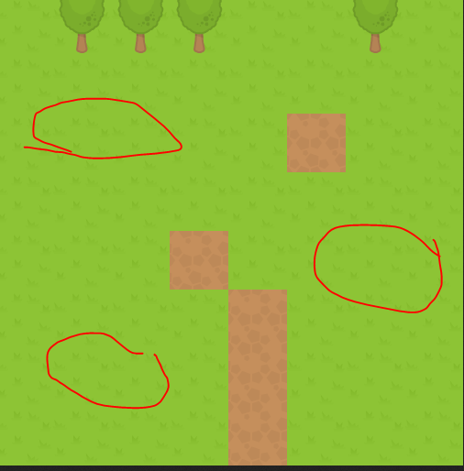
Tile Maps
A tilemap is a technique for creating a game world out of modular building blocks.
When you break a world down into small blocks/pieces, you get memory, performance and creative advantages.
Alternative to creating large background images for games.
Useful for repeating patterns

Slide 58
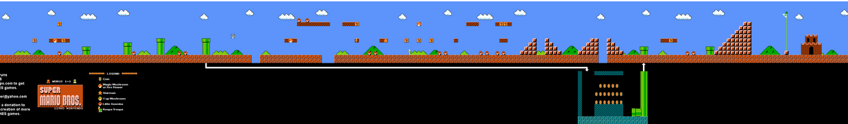
Example
Imagine trying to recreate Mario from scratch. Let’s say we decide to try loading each level as a giant image file. World 1–1 would be over 3500px wide
We’d need a lot of pixels to store that 32 levels for example.
it would be hard to sync up the image with logic with the game. Which pixels can Mario stand on? Which pixels correspond to pipes he can enter?

Slide 59
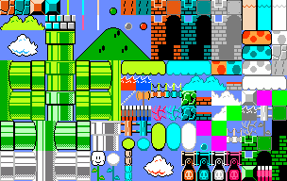
Example-continue
The tilemap approach defines a set of modular, regularly-sized tiles مربعات متساوية الأبعاد that we can use to build our levels. That way, we only need one image, a tileset:

Slide 60
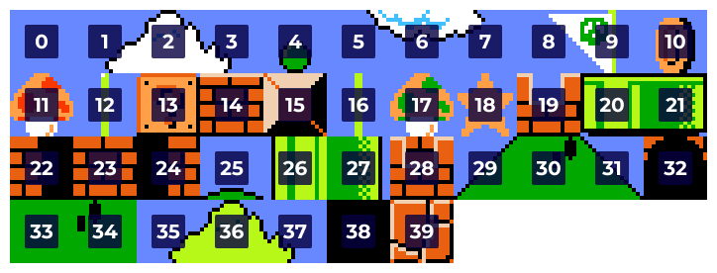
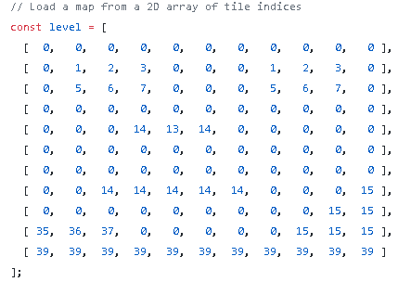
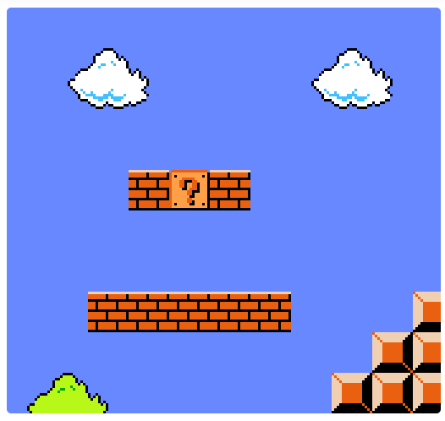
Example-continue 2
We can represent tilemap as 2D matrix in code

Slide 61
Part2- Some Techniques for Game Development

Slide 62
1- Collision Detection
Almost every video game needs to respond to objects touching each other in some sense, a practice commonly known as collision detection.
Whether it’s simply to prevent the player character from walking through the walls of your maze with a simple collision grid array, or if it’s to test if any of the hundreds of projectiles fired by a boss character in a top-down shoot them em-up have struck the player’s ship, your game will likely require a collision detection system of one sort or another.
62

Slide 63
hitboxes
Hitboxes are imaginary geometric shapes around game objects that are used to determine collision detection.
Imagine you have a player figure. You won't check its arms and legs for collision but instead just check a big imaginary rectangle that's placed around the player.
https://spicyyoghurt.com/tutorials/html5-javascript-game-development/collision-detection-physics

Slide 64
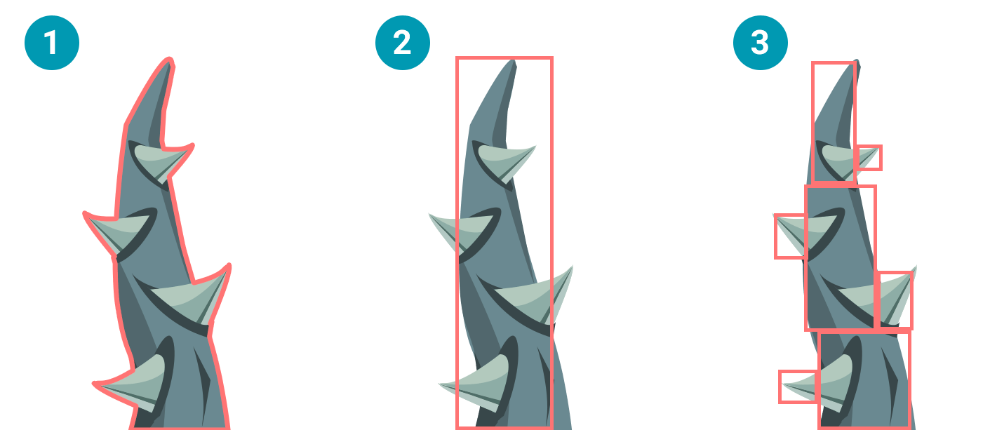
Types of hitboxes
The following image demonstrates the different types of collision detection. They each have their own advantages and disadvantages:
Pixel perfect - Super precise collision detection, but it requires some serious system resources. In most cases this is an overkill.
Hitbox - Much better performance, but the collision detection can be pretty imprecise. In many game scenario's though, this doesn't really matter.
Multiple hitboxes - Less efficient then a single hitbox but it still outperforms the pixel perfect variant. And you can support complex shapes. This is a nice option to use for important game objects that need some extra precision, like the player for example. You could make a hitbox for the core and separates ones for arms, legs and the head.
https://spicyyoghurt.com/tutorials/html5-javascript-game-development/collision-detection-physics

Slide 65
Common Hitboxes
In 2d there are some common geometric shapes for hitboxes:
Circles
Box (rectangle)

Slide 66
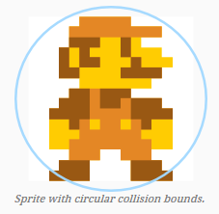
1-1 Bounding sphere/circle test
he simplest of all methods for detecting intersections between objects is a simple bounding sphere test. Essentially, this represents objects in the world as circles or spheres, and test whether they touch, intersect or completely contain each other. This method is ideal when accuracy is not paramount, for objects roughly circular in shape, or in instances where these objects do a lot of rotations.
Each object will have a bounding circle defined by a centre point and a radius.

Slide 67
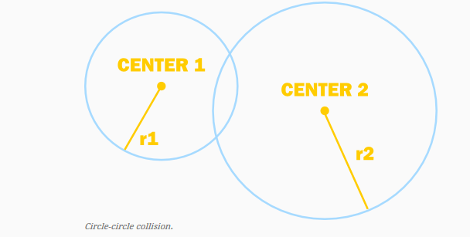
Steps of Circle test
To test for collision with another bounding circle, all that needs to be done is compare the distance between the two center points with the sum of the two radii:
f the distance exceeds the sum, the circles are too far apart to intersect.
If the distance is equal to the sum, the circles are touching.
If the distance is less than the sum of the radii, the circles intersect.

Slide 68
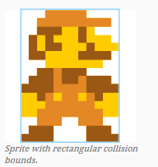
1-2 Bounding box test
The second obvious solution to the problem is to represent obstacles as axis-aligned rectangles. This method is ideal for smaller objects that are roughly rectangular and because it is incredibly fast to process.

Slide 69
Steps of Box Testing
The method that will be described uses a contradiction to determine whether the rectangles intersect. Because it is simpler instead to determine whether rectangles do not intersect, the function will calculate that and return the negation of its result.

Slide 70
Steps of Box Testing-2
Rectangles will be defined by their left-, top-, bottom- and right-edges. To determine whether two rectangles do not intersect, one simply has to check for any of the following conditions:
Rectangle 1’s bottom edge is higher than Rectangle 2’s top edge.
Rectangle 1’s top edge is lower than Rectangle 2’s bottom edge.
Rectangle 1’s left edge is to the right of Rectangle 2’s right edge.
Rectangle 1’s right edge is to the left of Rectangle 2’s left edge.
Rectangle-1
Rectangle-3
Rectangle-2
Rectangle-4

Slide 71
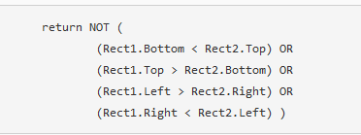
Steps of Box Testing-3
The above can then be condensed into a single line as follows.

Slide 72
3- Dealing with Complexity: Simplified Geometry
Approximate complex objects with simpler geometry, like this ellipsoid
72

Slide 73
Dealing with Complexity: Box Bounding Volumes

Slide 74
Axis-Aligned Bounding Box (AABB)
Box edges aligned to world axes
Recalculate bounds when object changes orientation
Collision checks are simplier
The other type is “Oriented Bounding Box”, which rotates with object rotation.
Essential Math for Games

Slide 75
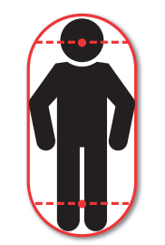
Bounding Capsule
In 2D, a capsule can be thought of as an AABB with two semicircles (half circles) attached to the top and bottom.
If we expand the capsule to 3D, it becomes a cylinder with two hemispheres attached to the top and bottom.
Capsules are also a popular form of collision representation for humanoid characters
الشخصيات القريبة من شكل الانسان

Slide 76
Unity 2D tutorials
Unity 2D
https://www.youtube.com/playlist?list=PLGmYIROty-5YhzMWqgAIXlPIRU2_tcz0l
Unity 3D
https://www.youtube.com/playlist?list=PLGmYIROty-5bpzKQNK3mRMi4pmh_LinV4
and
https://www.youtube.com/playlist?list=PLhPa7T8XPi0I7XkxrTEYyyU_YR1sePyTE

Slide 77
Animation basics

Slide 78
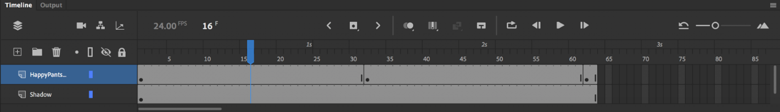
Animation Vocabulary
1) Timeline
The timeline is the part of the animation software that represents the animation's progress over time.

Slide 79
Animation Vocabulary- continue
2) Frame Rate
The frame rate of an animation is the number of individual images (or frames) that are being displayed over the span of one second. It is a setting you can adjust in the animation software.
Animation is usually done in 24 frames per second (FPS).
2) Working on One's & Two's
Working on One's or Two's is a term used in hand drawn animation.
Working on one's would mean doing a new drawing over every single frame of the animation.
Working on twos means holding each drawing for two frames, so one second of animation at 24 frames per second would only be 12 drawings, not 24.
In 2D animation working on two's looks fine in most instances, and there are even cases where drawings can be held longer. In 3D, though, working on one's is the standard.

Slide 80
Animation Vocabulary- continue
4) Shots & Scenes
Normally in live action filmmaking, the term 'shot' refers to the images between camera edits, while a scene is all the shots and dialogue that take place at a particular location for a continuous block of time.
In animation, however, we often use the term 'scene' and 'shot' interchangeably. When we talk about a scene/shot, we often refer to one specific continuous piece of animation in between camera cuts.
5) Keyframes | Breakdowns | Inbetweens
Key frames, breakdowns and in-betweens are important terms, but they mean slightly different things depending on the type of animation.
In hand drawn animation, keyframes (or just keys) are the major important poses that define the scene. Breakdowns come between keys and define what the motion from key to key will be. In-betweens are all the frames that come in between to smooth out the motion.

Slide 81
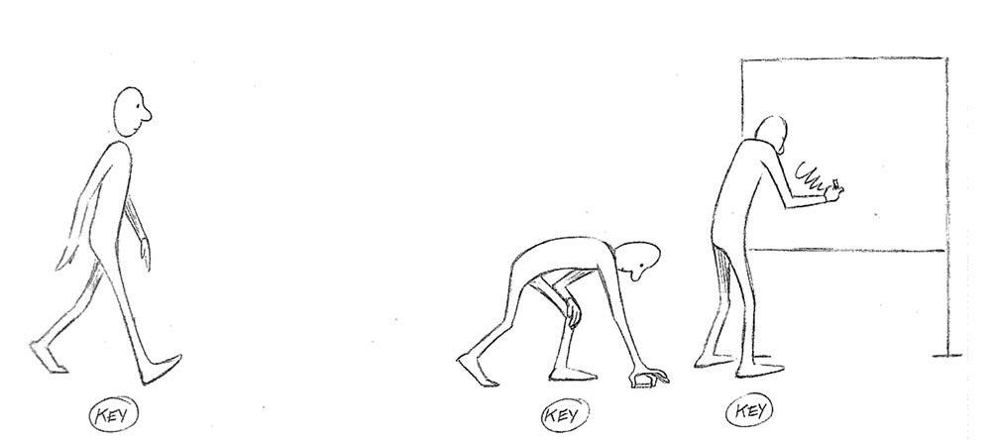
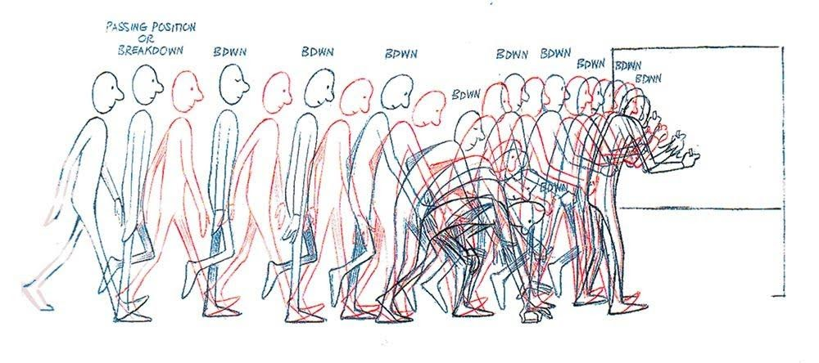
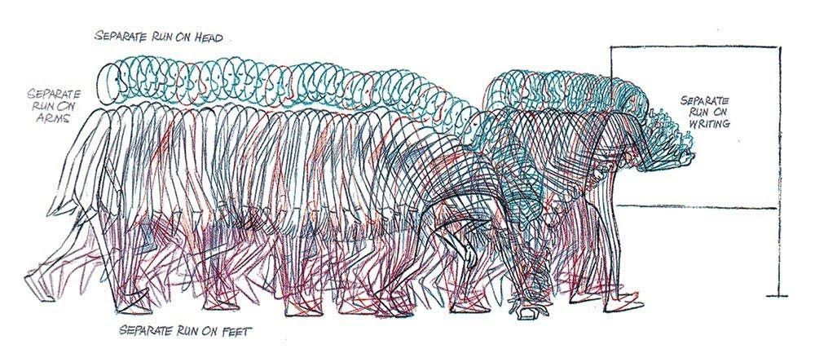
Keyframes
Breakdowns
In-betweens

Slide 82

Animation Vocabulary- continue
6)Timing | Spacing | Easing
Timing, spacing and easing are closely related terms.
Timing means the total number of frames that will be used for a movement. Spacing is the amount of change that comes between each frame. Decreasing the spacing, makes an object slower, while increasing the spacing makes it look faster.
In digital animation, easing is how spacing is controlled, usually through a motion graph on the timeline.

Slide 83
Common Animation Types

Slide 84

1- Hand-drawn Animation
In this type of animation, a series of drawings is photographed
Each drawing makes up one frame of the film
The position of the character or object changes very slightly from frame to frame
This technique is known as cell animation because the first animations were drawn on thin plastic sheets called celluloid

Slide 85

2-Stop-Motion Animation
In Stop-Motion Animation, models are photographed on a set one frame at a time.
The frames are played in sequence to create movement
Early stop-motion models were made of modeling clay

Slide 86
Stop motion
Stop-motion animation is used to describe animation created by physically manipulating real-world objects and photographing them one frame of film at a time to create the illusion of movement.
There are many different types of stop-motion animation, usually named after the medium used to create the animation. Computer software is widely available to create this type of animation.

Slide 87

2-1. Puppetoon عرائس متحركة
In puppetoon animation the puppets are rigid and static pieces;
each is typically used in a single frame and then switched with a separate, near-duplicate puppet for the next frame.

Slide 88


2-2 Clay animation or claymation
A subtype of stop motion animation.
Each animated piece, either character or background, is "deformable"—
قابلة لتغيير الشكل بالضغط عليها

Slide 89

3-Computer Animation
Computer Animation software can be used to create an animation scene, cartoon, a video game, or even a full-length movie
Computer Animation reduces the time needed to produce an animated film
Software can be two-dimensional (2D) or three-dimensional (3D)

Slide 90

4- Motion Capture Animation
Motion Capture Animation is a 3D representation of a live performance
It can be done using 3 different technologies:
Magnetic
Optical
Electro-Mechanical

Slide 91

4-1. Magnetic Motion Capture
Magnetic motion capturing uses sensors placed on an actor’s body that measure magnetic fields created by a transmitter
The files are then represented in 3D by a computer

Slide 92

4-2. Optical Motion Capture
Optical motion capturing uses video cameras to track the motion of light-emitting diodes or reflective markers placed on the joints مفاصل of the actor’s body

Slide 93

4-3.Electro-mechanical Capture
Electro-mechanical devices resemble an exoskeleton
بدلة تماثل الهيكل الخارجي للشخصية that is worn by the actor being recorded. The exoskeleton’s movements are recorded without any additional sensors

Slide 95

Cutout animation
is a type of stop-motion animation produced by moving two-dimensional pieces of material such as paper or cloth.

Slide 96

7- Rotoscoping
where animators trace live-action movement, frame by frame. The source film can be directly copied from actors' outlines
الحدود الخارجية لصورة الشخصية
into animated drawings

Slide 97

8-Silhouette animation
is a variant of cutout animation in which the characters are converted to shadows and only visible as silhouettes
ظلال .

Slide 98
Part 2- Animation Principles and visualization techniques

Slide 99

Recommended Textbook (This Lecture)
3D Animation Essentials, Andy Beane ,chapter 4

Slide 100
3-Character Animation
12 Basic Principles of Animation (Created at at Walt Disney Animation Studios):
Squash and stretch
Anticipation
Staging
Straight-ahead action and pose-to-pose
Follow-through and overlapping action
Slow-in and slow-out
Arcs
Secondary action
Timing
Exaggeration
Solid drawing
Appeal

Slide 101

Reference Playlist
Excellent video playlist (youtube)
https://www.youtube.com/playlist?list=PL-bOh8btec4CXd2ya1NmSKpi92U_l6ZJd

Slide 102
3-1.Squash & stretch ضغط وتمدد
A given object possesses some degree of rigidity صلابة and intuitively has some amount of massكتلة .
This is reflected in the distortion (squash and stretch) of its shape during an action.

Slide 103

Squash & stretch

Slide 104
3-2.Anticipation
The setup before the main action.
It lets the audience know that something is about to happen and gathers the necessary energy.
Why?
In animation, a viewer’s eye ends to lag behind تأخير by a few frames, so it is often necessary to announce that something is about to happen so your audience doesn’t miss it.
Anticipation are often physical movements in the opposite direction of the intended motion.
Exception: a growl before an attack or a deep breath before a bold statement.

Slide 105
3-3.Staging (Composition)
Successful staging will result in the clear presentation of an idea.
Choose the best scene layouts,T iming and camera angles to deliver that story with appropriate style and mood.
If a scene has a singular focus, you need to decide whether it should be centered or perhaps off to the side a bit.
Maybe the best staging for a particular shot would be to put its main focus off the screen (Rule of Third
تقسيم الشاشة لثلاثة أجزاء بالعرض والطول) and reveal the action with sound or dialogue.

Slide 106


Staging
Poses should be strong, and elements of your scene should work well together visually.
Typically, you should not hide important scene elements behind less important elements

Slide 107



Staging

Slide 108

The rule of thirds Example

Slide 109
3-4.Pose-to-pose & straight ahead action
Pose to pose
Involves defining the extremes & then filling in the spaces in between.
Straight Ahead
Involves stepping through the individual frames of your scene and manipulating them sequentially.
Requires more pre-planning
Used for stop motion

Slide 110


Example for Animation Sheets
Example 1: Running Horse

Slide 111

Example 2

Slide 112

Example 3

Slide 113
3-5.Follow-through & overlapping action قصور ذاتي للزوائد+ تداخل التوقيتات
The extension of a main action.
Occur when a secondary appendage
زوائد , e.g. a tail or an antenna, is indirectly driven by the primary motion of the body.
Occur later than the main action as the force dictating the main action takes longer to reach the appendages.
When an object in motion changes direction, stops accelerating, or stops completely, secondary parts of that object will continue in original direction after the change in the main force.
Follow-through is often reduced if an appendage has & uses its own muscles.

Slide 114


Follow-through & overlapping action

Slide 115
3-6.Slow-in and slow out
The acceleration and deceleration of action, i.e. the way that an action begins slowly, moves quickly through the main action, and then slows down as it comes to a stop rather than moving linearly from one position to another.

Slide 116

Tip: Easing Functions منحنى تغير السرعة

Slide 117
3-7.Arcs أقواس
The visual path of action for natural movement.
Straight-line paths look mechanical.
Arcs show the most natural route.
With computer animation the in between frames may follow straight lines - may need to add a curve too it to make it more realistic.
Using arcs to animate the movements of characters helps achieve a natural look because most living creatures move in curved paths, never in perfectly straight lines.

Slide 118
3-8.Secondary action فعل هامشي
Any motion that is secondary to the main action.
Secondary action often reveal emotional subtleties or hidden thoughts.
If secondary action pulls the viewer’s attention away from the main action, however, it becomes the main action.

Slide 119
3-9. Timing
Realism of an object depends on how it looks and moves.
The precise moment and the amount of time that a character spends on an action.
Timing adds emotion and intention to the character’s performance.
The timing of a response to someone calling us, or a noise; tells a lot about our attitude, confidence and disposition.

Slide 120
Timing
Not too slow or audience eyes wander.
Not too fast or action is misunderstood.
The faster the motion, the more critical it is to make the audience focus on it.

Slide 121
3-10.Exaggeration
To increase the readability of emotions and actions.
To effectively tell the story of a particular performance.
Animation medium don’t deliver all of the same information that exists in real life.
Effective exaggeration isn’t always a matter of making a motion larger.
Significant decreasing an action is also a type of exaggeration.
E.g. completely stopping a character’s motion for an unnaturally long period of time can demonstrate a particular emotion, e.g. shock or disgust.
Exaggeration is especially appropriate in cartoon-style animation.

Slide 122
3-11. Solid drawing /modeling & rigging
Each individual drawing should be a work of art on its own.
Each drawing should look like the character being presented.
Avoid inconsistency in terms of character’s size & volume

Slide 123
3-12. Appeal جذب انتباه
In the context of animation, appeal means that a character or its performance is visually interesting.
The most subjective of all the principles.
Is the presentation of your idea pleasant (or unpleasant) to look at?
Apply fundamental aesthetic principles to your shots—though appeal doesn’t necessarily mean attractive.

Slide 124
Part 3 Lighting & Camera Movements

Slide 125

1-Three-Point Lighting
Most basic type of lighting setup is the three-point light set:
Key light
Fill light
Rim/kicker light(s)

Slide 126
1-1 Key light
Left Or Right to the camera and above the subject.
This is the strongest light in the setup
casts the majority of the light

Slide 127
1-2 Fill light
opposite the key light
at the same level or slightly lower than the subject.
The fill light has half of the light intensity of the key light
prevents the shadows of the subject from dropping down to pure black

Slide 129

Example

Slide 130


Camera Movements
Pan A pan (Figure 4.40) is a rotation of the camera side to side, horizontally
Tilt A tilt (Figure 4.41) is a rotation of the camera up or down, vertically.

Slide 131


Camera Movements (2)
3- Roll This involves rotating the camera on its side or upside down. This kind of camera rotation will allow the camera to roll 360 degrees if needed for effect.(See Figure 4.42.)
4- Dolly A dolly (Figure 4.43) can move the camera forward or backward, toward or away from the subject. This move can be completed by hand, but typically the camera is mounted to a dolly مزلقان مستقيم that is pushed.

Slide 132


Camera Movements (3)
5-Track You can move the camera along a track مزلقان بأي شكلto follow the subject,
6-Pedestal A pedestal (Figure 4.45) tracks the height of an object by moving the camera vertically.

Slide 133

Camera Movements (4)
6- Crane shot: رافعة
film technique where the camera takes a shot from a crane/drone. A crane enables the camera to traverse great distances up and down, as well as forward and backward and from side to side, while flying high in the air.

Slide 134

Camera Movements (5)
7- Zoom A zoom is different from the other camera moves because you are not physically moving the camera, but rather moving the lens to create movement in the frame.

Slide 135

Camera Movements (5)
8-Handheld A handheld movement (Figure 4.47) entails holding the camera and moving freely in any direction to follow the action. This movement is good for horror or action films because it allows the viewers to feel as if they are actually immersed in the action.
But handheld Movement must be used wisely; overuse can be jarring to the audience. (Example Cloverfield movie).

Slide 136

Camera Movements (6)
9-Rack Focus This involves changing the focus of the camera to push an object that is out of focus into focus, or vice versa. Figure 4.48 shows an example. In the 3D animation world, rack focus can be accomplished in the software’s 3D camera but is typically achieved in the postproduction stage with compositing software.

Slide 137
References
www.roguebasin.com/index.php?title=Dungeon-Building_Algorithm - www.roguebasin.com/index.php?title=Java_Example_of_Dungeon-Building_Algorithm - openprocessing.org/visuals/?visualID=18822
- www.roguebasin.com/index.php?title=Basic_BSP_Dungeon_generation - stackoverflow.com/questions/4997642/simple-example-of-bsp-dungeon-generation
- pcg.wikidot.com/pcg-algorithm:dungeon-generation - donjon.bin.sh/dungeon/about/ - www.policyalmanac.org/games/aStarTutorial.htm

